Slide 1

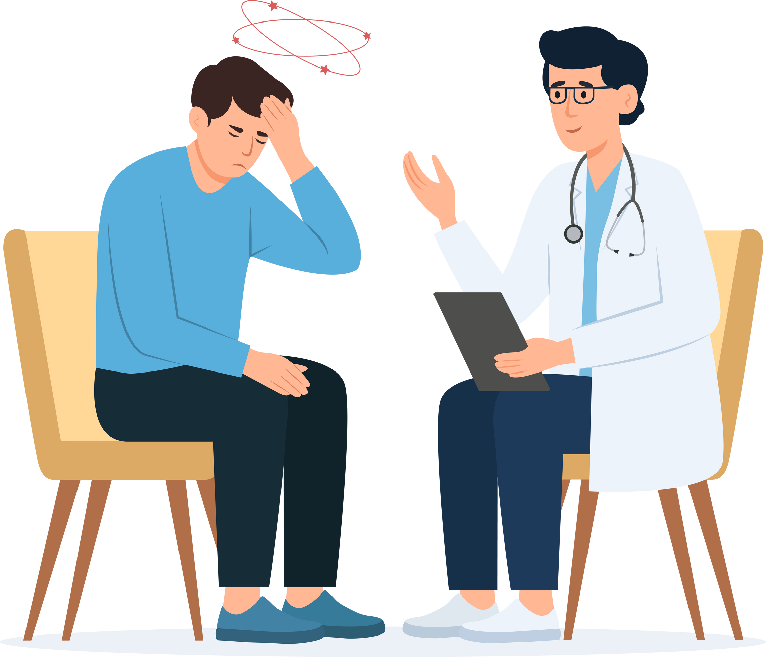
up-end migraine
UNDERSTANDING MIGRAINE PREVENTION NEEDS
Section 1.0
Understanding the Diagnostic Criteria for Migraine (ICHD-3)

Slide 2




Lesson Objectives
Identify the key diagnostic criteria for migraine according to the ICHD-3 classification.
Apply the diagnostic criteria to improve accuracy and address common challenges in migraine diagnosis.
Examine disparities in migraine diagnosis.
Highlight methods that can expedite migraine diagnosis.

Slide 3
1.1 What are the criteria?
The International Headache Society's International Classification of Headache Disorders, 3rd Edition (ICHD-3) outlines specific criteria for diagnosing migraines. Key criteria include:
Recurrent headaches
≥5 attacks
Duration of 4–72 hours*
*untreated or unsuccessfully treated
Two or more of the following:
Unilateral location, pulsating quality, moderate to severe pain intensity, Aggravation by or causing avoidance of routine physical activity
One or both of the following:
Nausea and/or vomiting, photophobia and phonophobia
Exclusion of other disorders
Exclusion of other disorders through clinical assessment

Slide 4



1.2 Barriers to Diagnosis
  Women are more frequently diagnosed with migraines, but hormonal factors are often misattributed as the sole cause, delaying proper diagnosis.
  Men tend to underreport headache symptoms, leading to underdiagnosis.
Minority populations, particularly Black and Hispanic patients, face significant underdiagnosis, driven by implicit bias and inequitable access to care or cultural beliefs that may downplay migraine severity.
Lower-income individuals experience delayed diagnosis due to restricted healthcare access, high costs, and/or lack of insurance coverage or health literacy.

Slide 5


How migraine stigma can get in the way:
Because migraines don’t always show on the outside, people often downplay them—which can lead to stigma, delays in care, and missed chances to recognize just how serious the symptoms really are.
Here’s what you can do

Slide 6




Strategies to Address Disparities
Provider Education
Cultural Competency
Improved Access
Patient Advocacy
Ensure healthcare providers can access training to recognize and diagnose migraine across diverse populations.
Integrate training to improve provider awareness of how different cultural groups express symptoms.
Expand specialized headache care and telemedicine services to underserved areas.
Encourage patients to report symptoms early, focusing on education in minority and low-income communities.

Slide 7

1.3 Methods that May Expedite Migraine Diagnosis
Telemedicine: Increases access to specialists, allowing for quicker assessments and follow-ups.
Patient Education and Self-Tracking: Equip patients with tools to track their symptoms (e.g., mobile apps), providing comprehensive data during consultations.
Collaborative Care Models: Streamline care pathways by involving neurologists and headache specialists early, ensuring rapid diagnosis and treatment adjustments.

Slide 8

Your Role in Change
By recognizing and addressing disparities, improving provider training, and utilizing technology, healthcare providers can accelerate the diagnosis of migraine, improving patient outcomes.

Slide 9
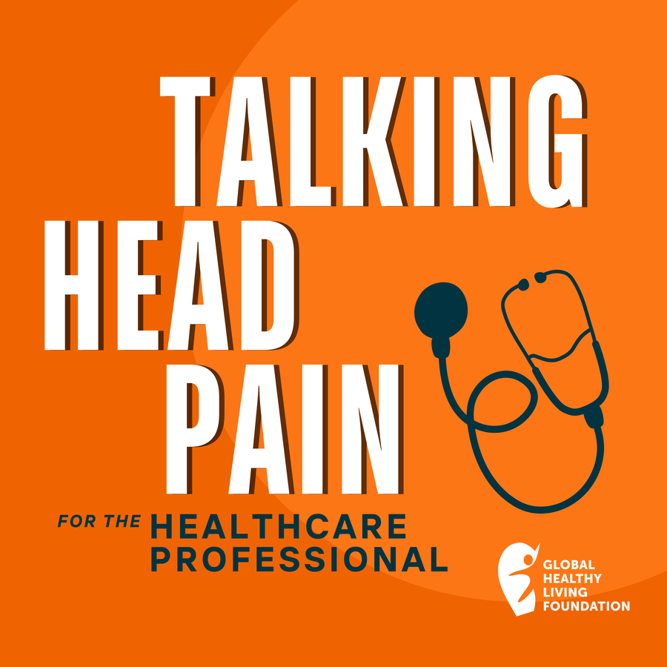

1.4 What Your Patients Want You to Know
“When we see and live through such discrepancies between how providers are treating migraine versus what patients are perceiving and experiencing, it makes me think that we have to do more to improve how providers and patients are connecting.”
-Erik, Migraine Patient
Listen to learn more

Slide 10
Your Next Steps
TEST YOUR KNOWLEDGE | LISTEN TO PATIENT STORIES | REFLECT ON YOUR PRACTICES
Take the short quiz to test your knowledge on key learnings from this module! | Listen to Talking Head Pain: For the Healthcare Professional Episode One - Earning the Diagnosis: Addressing Barriers to Migraine Diagnosis | Reflect: How can you use this module’s learnings in your current profession or work environment?

