Slide 1


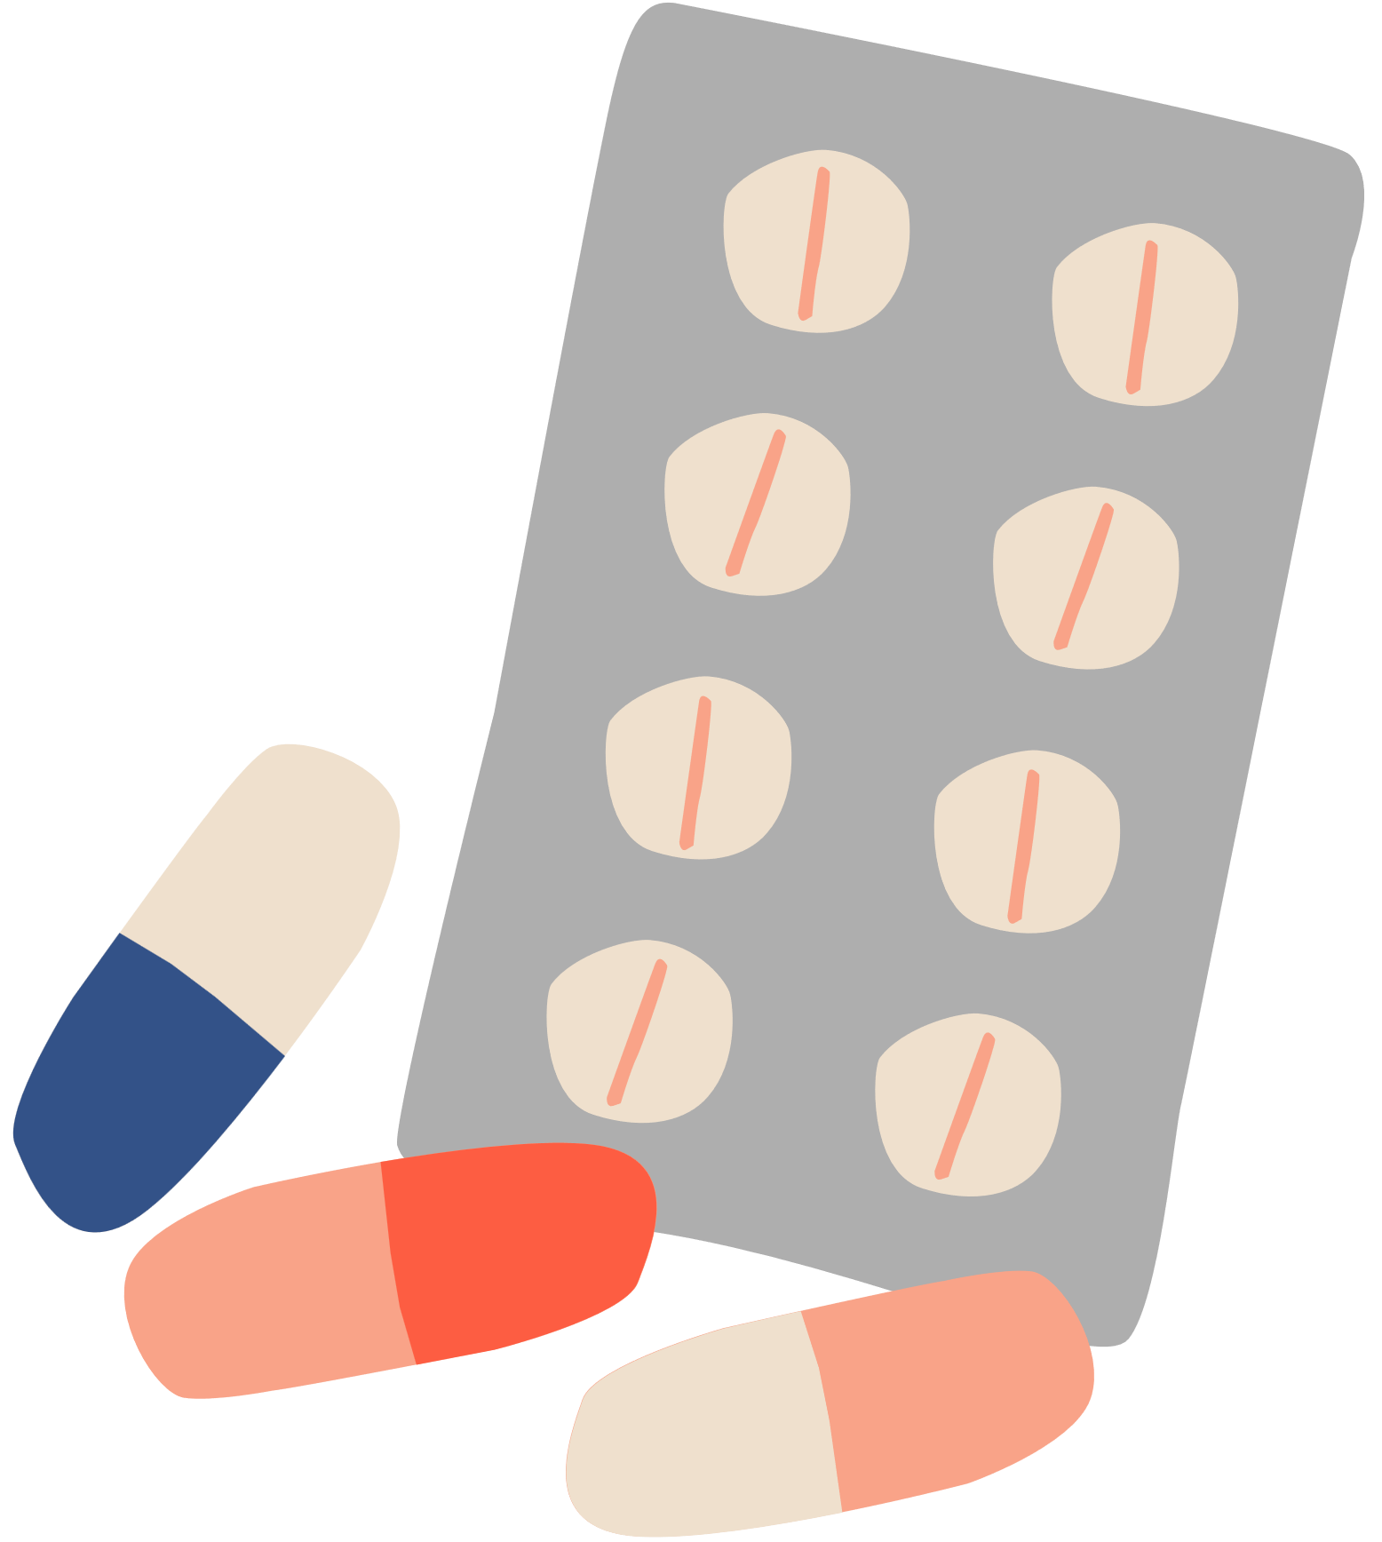

up-end migraine
UNDERSTANDING MIGRAINE PREVENTION NEEDS
Section 2.0
When to Consider Preventive Treatment for Migraine

Slide 2



Lesson Objectives
Identify key criteria for initiating preventive treatment based on migraine frequency, severity, and impact on daily life.
Understand the role of preventive treatments in preventing medication overuse headache and reducing migraine progression.
Assess when preventive treatment is appropriate, particularly when acute treatments are ineffective or poorly tolerated.

Slide 3


What is Preventive Treatment?
Preventive migraine treatment is recommended when attacks become frequent, severe, or significantly impact daily life. The goal is to improve function, reduce attack frequency, severity, and the risk of progression to chronic migraine.

Slide 4
2.1 When Should Preventive Treatment Be Offered?
Preventive therapy should be considered if a patient experiences:
Frequent attacks
≥4 migraine days per month.
Disability
≥3 migraine days per month and attacks that severely impact daily activities.
Medication overuse risk
Frequent use of acute treatments.
Inadequate response to acute treatment
If relief is not achieved with first-line medications or if acute treatments are intolerable or contraindicated.

Slide 5
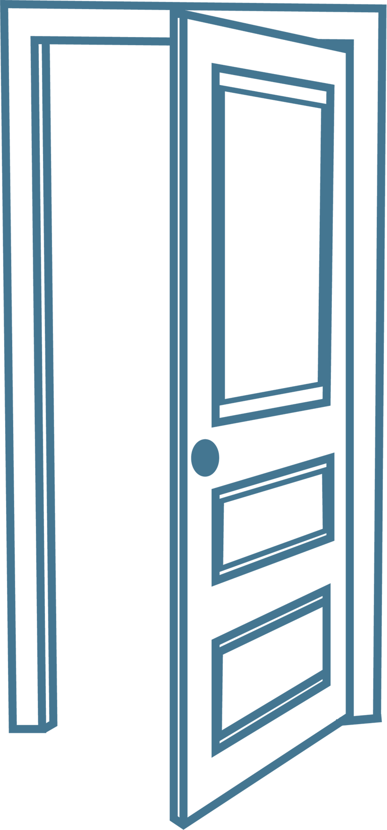

2.2 “4 or More? Shut the Door!”
“4 or More? Shut the Door!” emphasizes that when patients experience four or more migraine days per month, it’s time to shut the door on worsening migraine by starting preventive measures.
Check out the downloadable graphic on the website to learn more!

Slide 6
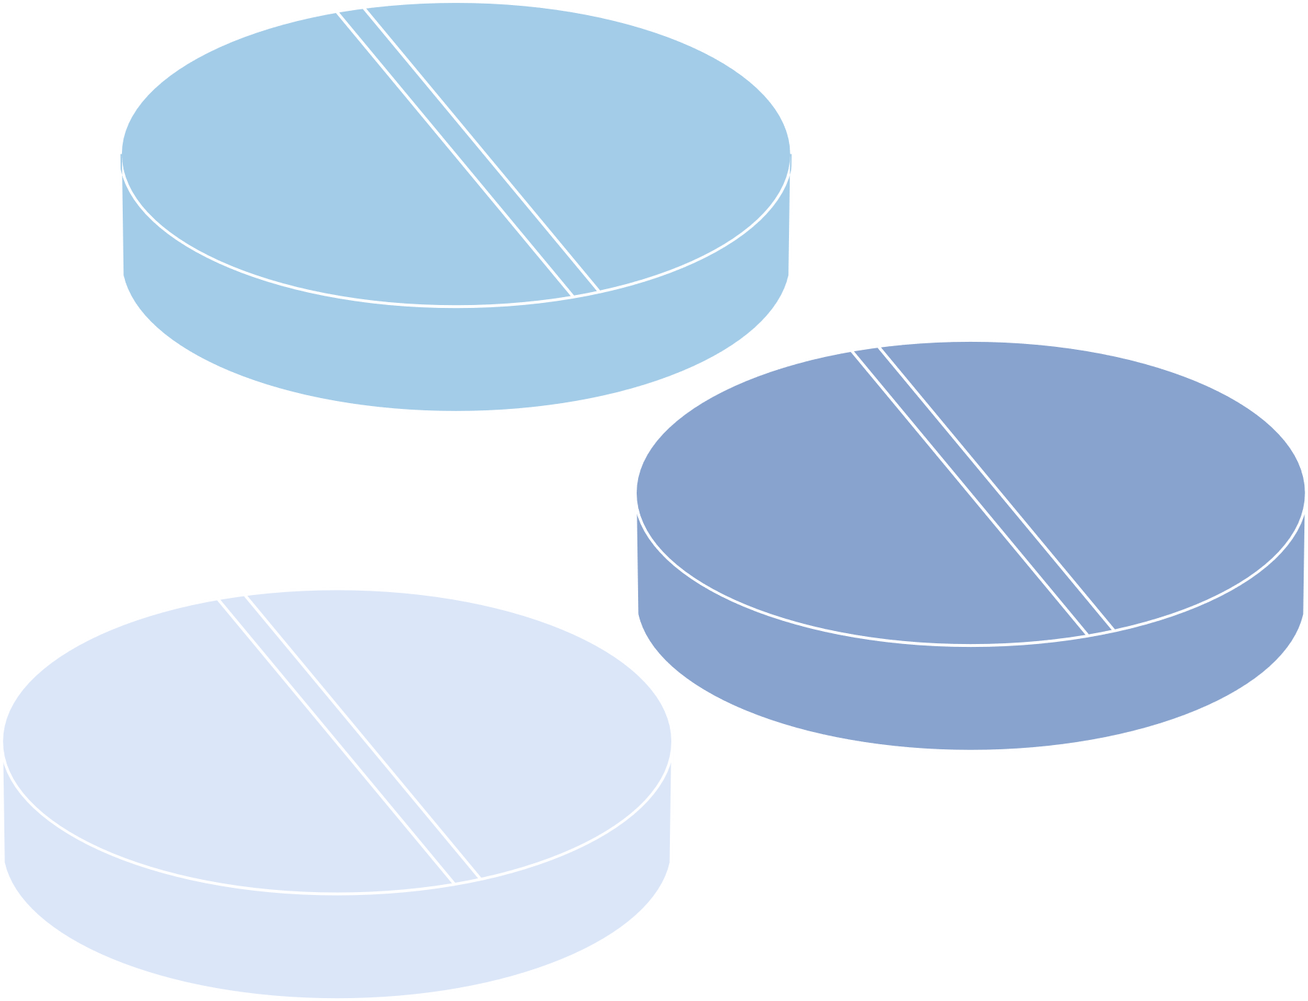
2.3 Preventing Medication-Overuse Headache (MOH)*
MOH occurs when acute migraine medications (like triptans, NSAIDs, etc.) are used too frequently, leading to worsened headaches over time, even when the medication isn’t being used to treat migraine.
*Also known as Medication Adaption Headache
Sometimes, MOH is also refferred to as Medication Adaption Headache (MAH). Using this language reduces stigma and emphasizes the body's physiological adjustment to frequent medication use rather than blaming the patient for overuse.

Slide 7










Strategies to Prevent Medication Adaption Headache
Limit acute medication use
Monitor use of painkillers
Use preventive treatments when needed
Educate patients on rebound headaches
Explore newer medications
No more than 2–3 days per week.
Avoid frequent use of opioids and analgesics
Newer medications for acute migraine, like gepants, may not cause medication adaption headache
Reduces reliance on acute medications.
Ensure they understand the risks of overuse and strategies to prevent it.

Slide 8
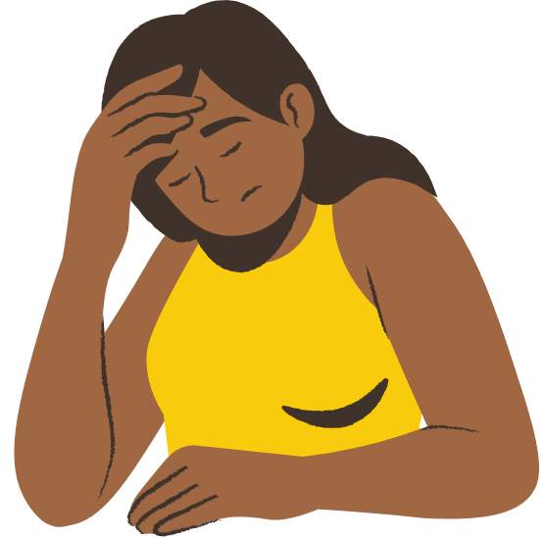
2.4 Reducing Attack Frequency & Preventing Progression
Early preventive treatment can stop episodic migraines from becoming chronic migraines (≥15 headache days/month).
By recognizing when to start preventive treatment and following strategies to reduce medication overuse, patients can take control of their migraine before it worsens.
Through a combination of awareness, lifestyle adjustments, and appropriate treatment options, healthcare providers can help reduce the burden of migraine and improve patient quality of life.

Slide 9
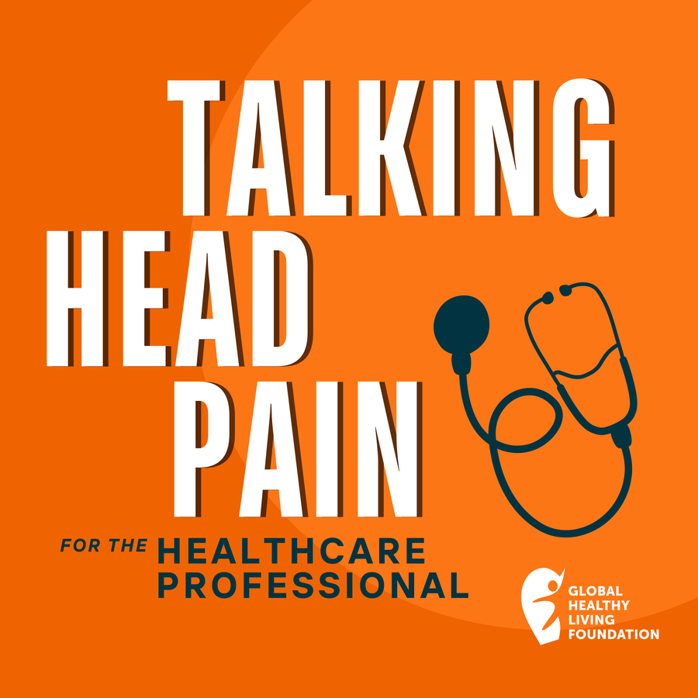

2.5 What Your Patients Want You to Know
“I see so much alignment between the questions that patients are asking and, and the questions that providers are asking...We all want migraine to be better.”
-Erik, Migraine Patient
Listen to learn more

Slide 10
Your Next Steps
TEST YOUR KNOWLEDGE | LISTEN TO PATIENT STORIES | REFLECT ON YOUR PRACTICES
Take the short quiz to test your knowledge on key learnings from this module! | Listen to Talking Head Pain: For the Healthcare Professional Episode Two - Four or More? Shut the Door! Preventing Migraine Progression | Reflect: How might you share this module’s key takeaways with others at work? For example, hanging up the downloadable flyer or sharing this video with them?

