Slide 1
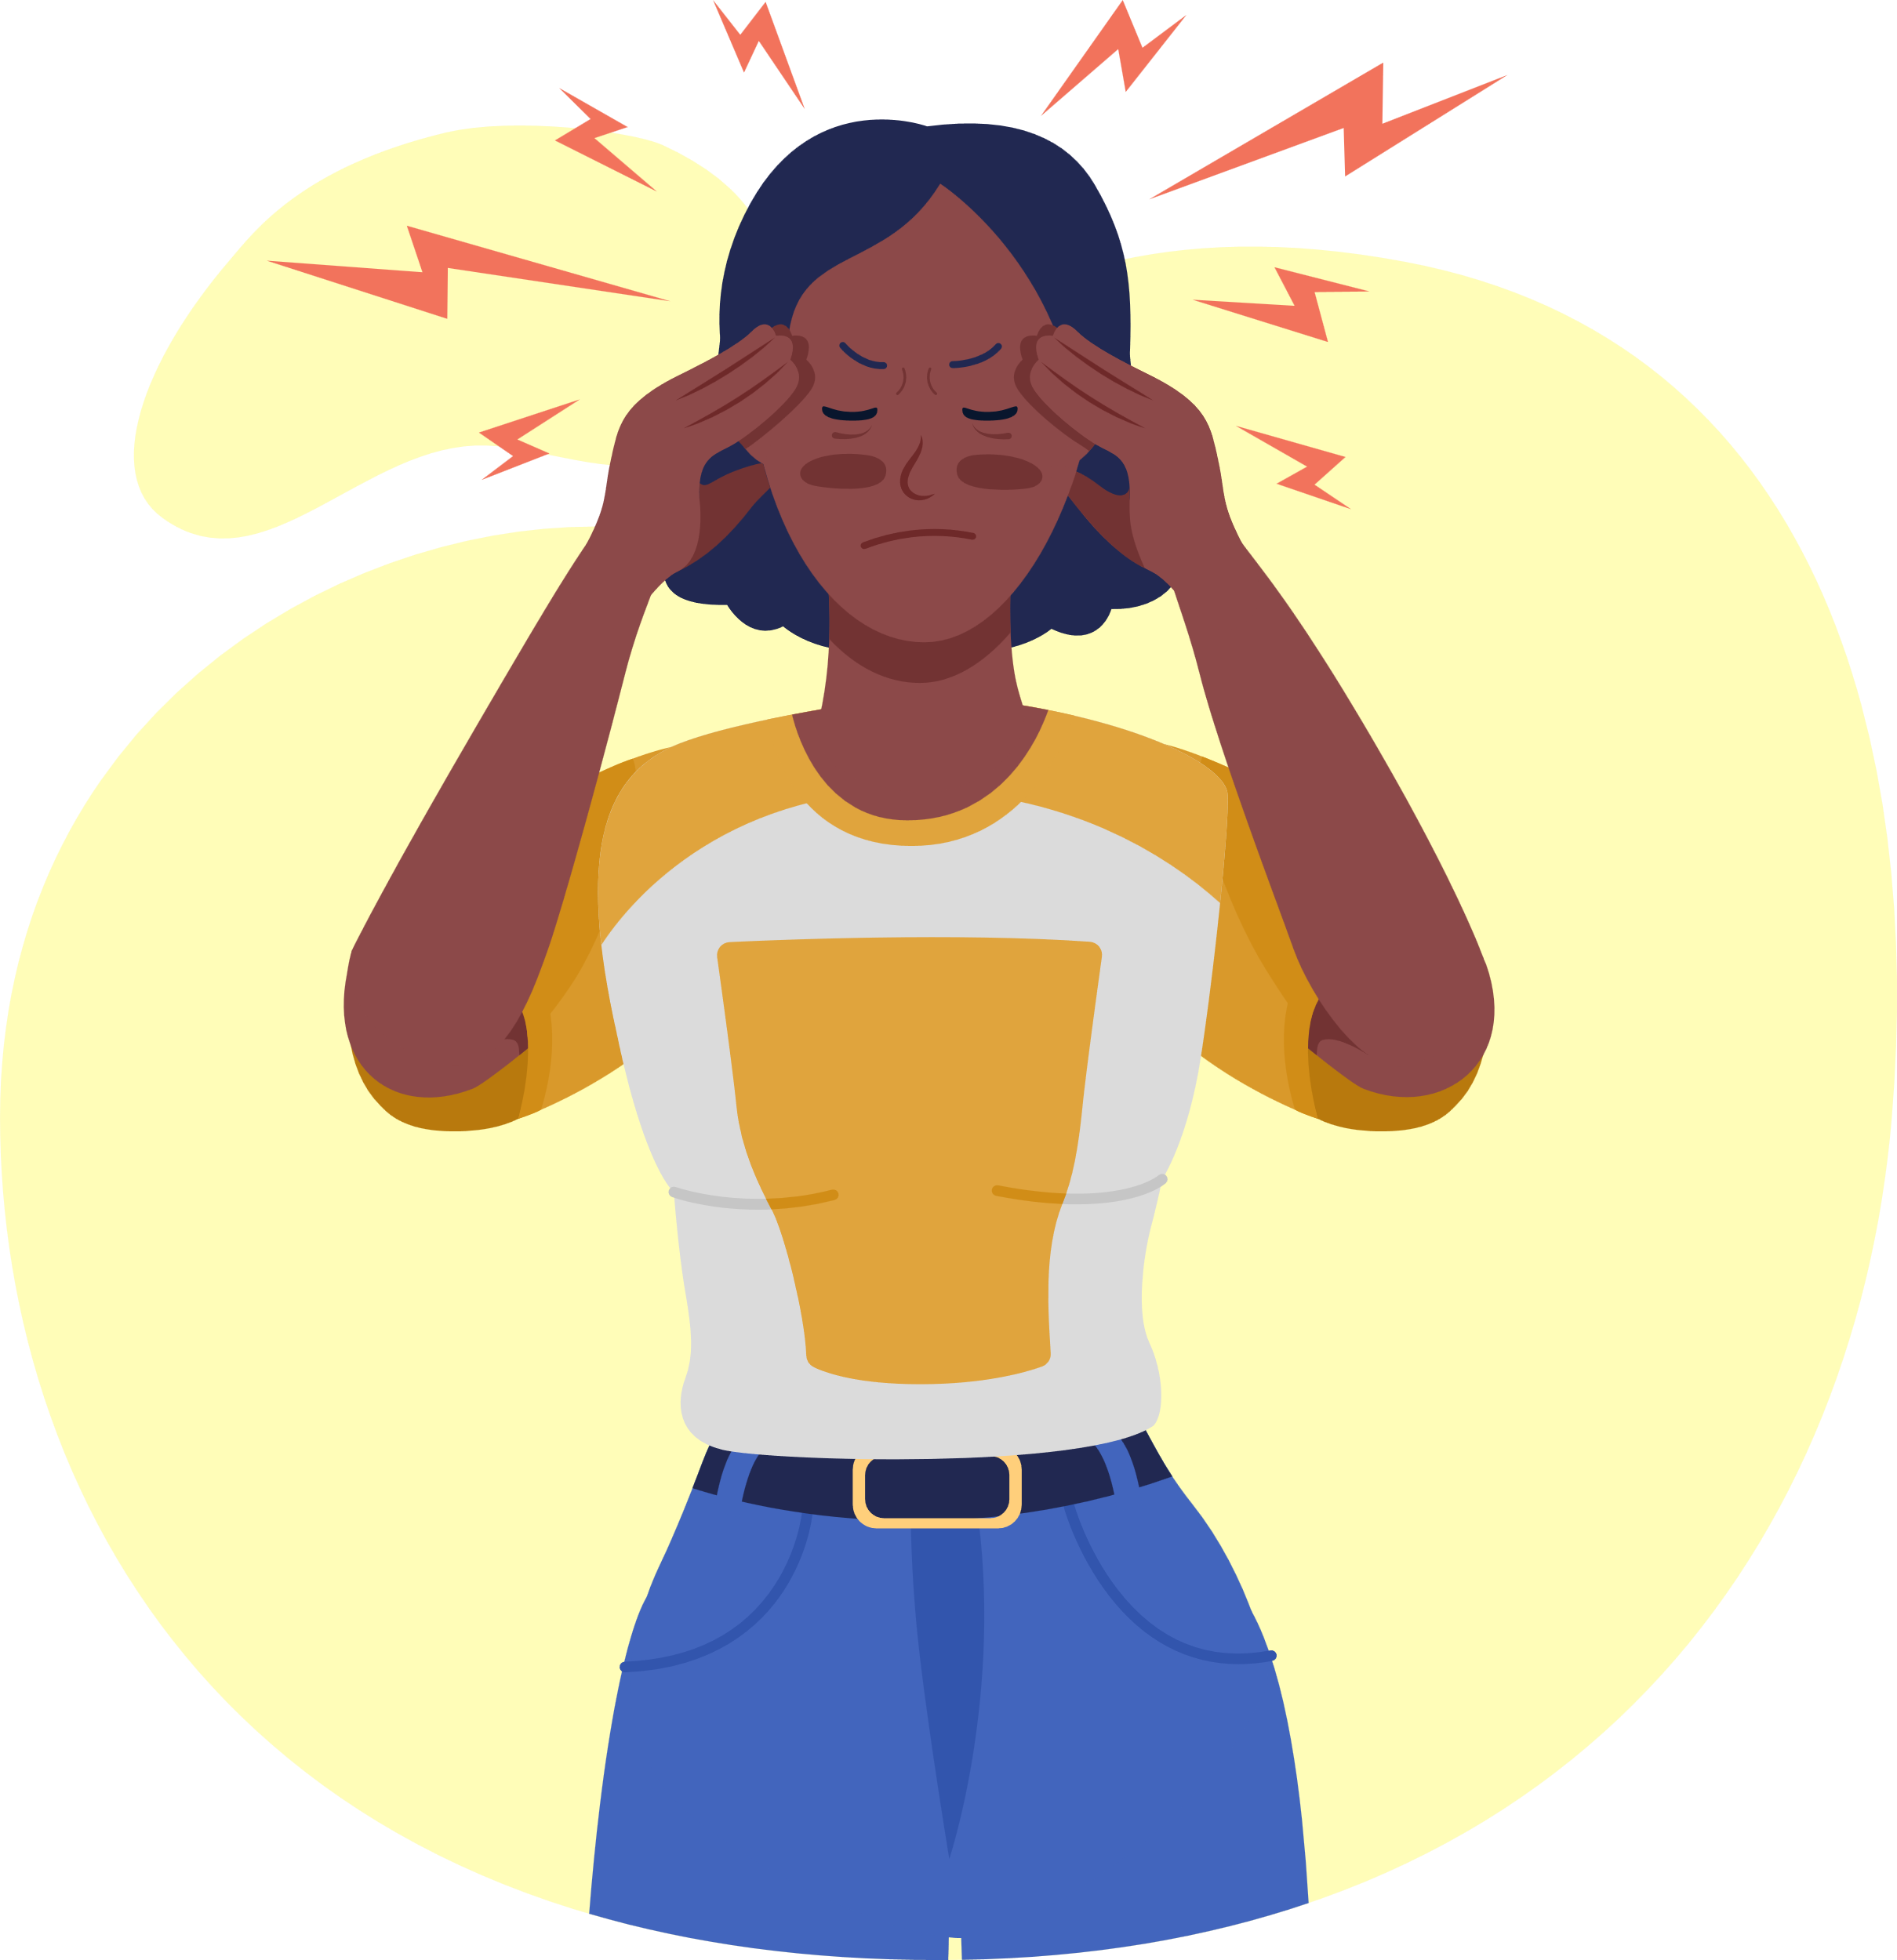

up-end migraine
UNDERSTANDING MIGRAINE PREVENTION NEEDS
Section 4.0
Advancements in Acute Migraine Treatment

Slide 2
Lesson Objectives
1
What is Acute Treatment?
2
Role of Acute Treatment
3
Choosing Treatments
Identify acute migraine treatments and their features.
Understand the role of acute treatments, even for those on preventive therapies.
Compare the efficacy, side effects, and contraindications of different treatments.
4
Personalizing Treatment
5
Managing Risks
Select appropriate acute treatments based on patient needs and comorbidities.
Recognize risks and manage them in acute migraine treatment.

Slide 3


What is acute treatment?
Acute migraine treatment is used to relieve the symptoms of a migraine once it has started. These treatments are taken at the onset of a migraine attack.
Preventive migraine treatment, on the other hand, is taken regularly—often daily—to reduce how often migraines occur, how severe they are, and how long they last.

Slide 4





4.1 Who Can Benefit from Acute Migraine Treatments?
Acute treatments are for patients who:
Have infrequent migraines and do not require preventive treatment.
Experience breakthrough attacks despite being on preventive therapy.
Need rapid* symptom relief to maintain daily functioning.
Cannot use or do not respond well to other migraine medications.
*Acute treatment should be taken as early as possible in an attack for the best effect.

Slide 5




4.2 Why Preventive Treatment Does Not Replace Acute Treatment
Preventive treatments reduce migraine frequency and severity but do not eliminate all attacks.
Patients may still experience breakthrough migraines due to triggers like stress, sleep disruption, or hormonal changes.
Both preventive and acute treatments work together to optimize migraine management.
Acute treatments help manage unpredictable attacks, ensuring patients can function when migraines occur.
Some preventive medications take weeks to months to reach full effect, requiring acute relief options in the meantime.

Slide 6
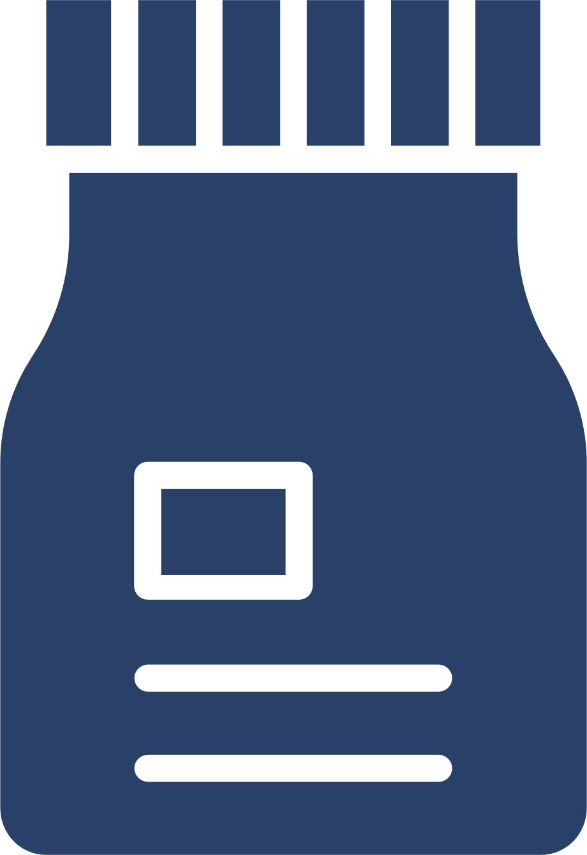

4.3 Acute Treatment Options
Triptans (Serotonin 5-HT1B/1D Agonists)
Gepants (CGRP Receptor Antagonists)
NSAIDs & Analgesics
Sumatriptan, Rizatriptan, Zolmitriptan
Ibuprofen, Naproxen, Aspirin
Rimegepant, Ubrogepant
Efficacy: Effective for many but limited for those with frequent attacks
Side Effects: Dizziness, chest tightness, fatigue
Contraindications: Not for those with cardiovascular disease or uncontrolled hypertension
Efficacy: Moderate efficacy, best for mild to moderate attacks
Side Effects: Gastrointestinal irritation, kidney risk with long-term uses
Contraindications: Caution in patients with ulcers, kidney disease, or GI disorders
Efficacy: Could be effective for those who do not respond to triptans
Side Effects: Nausea, fatigue and constipation
Contraindications: Generally well-tolerated, but caution in severe liver disease

Slide 7
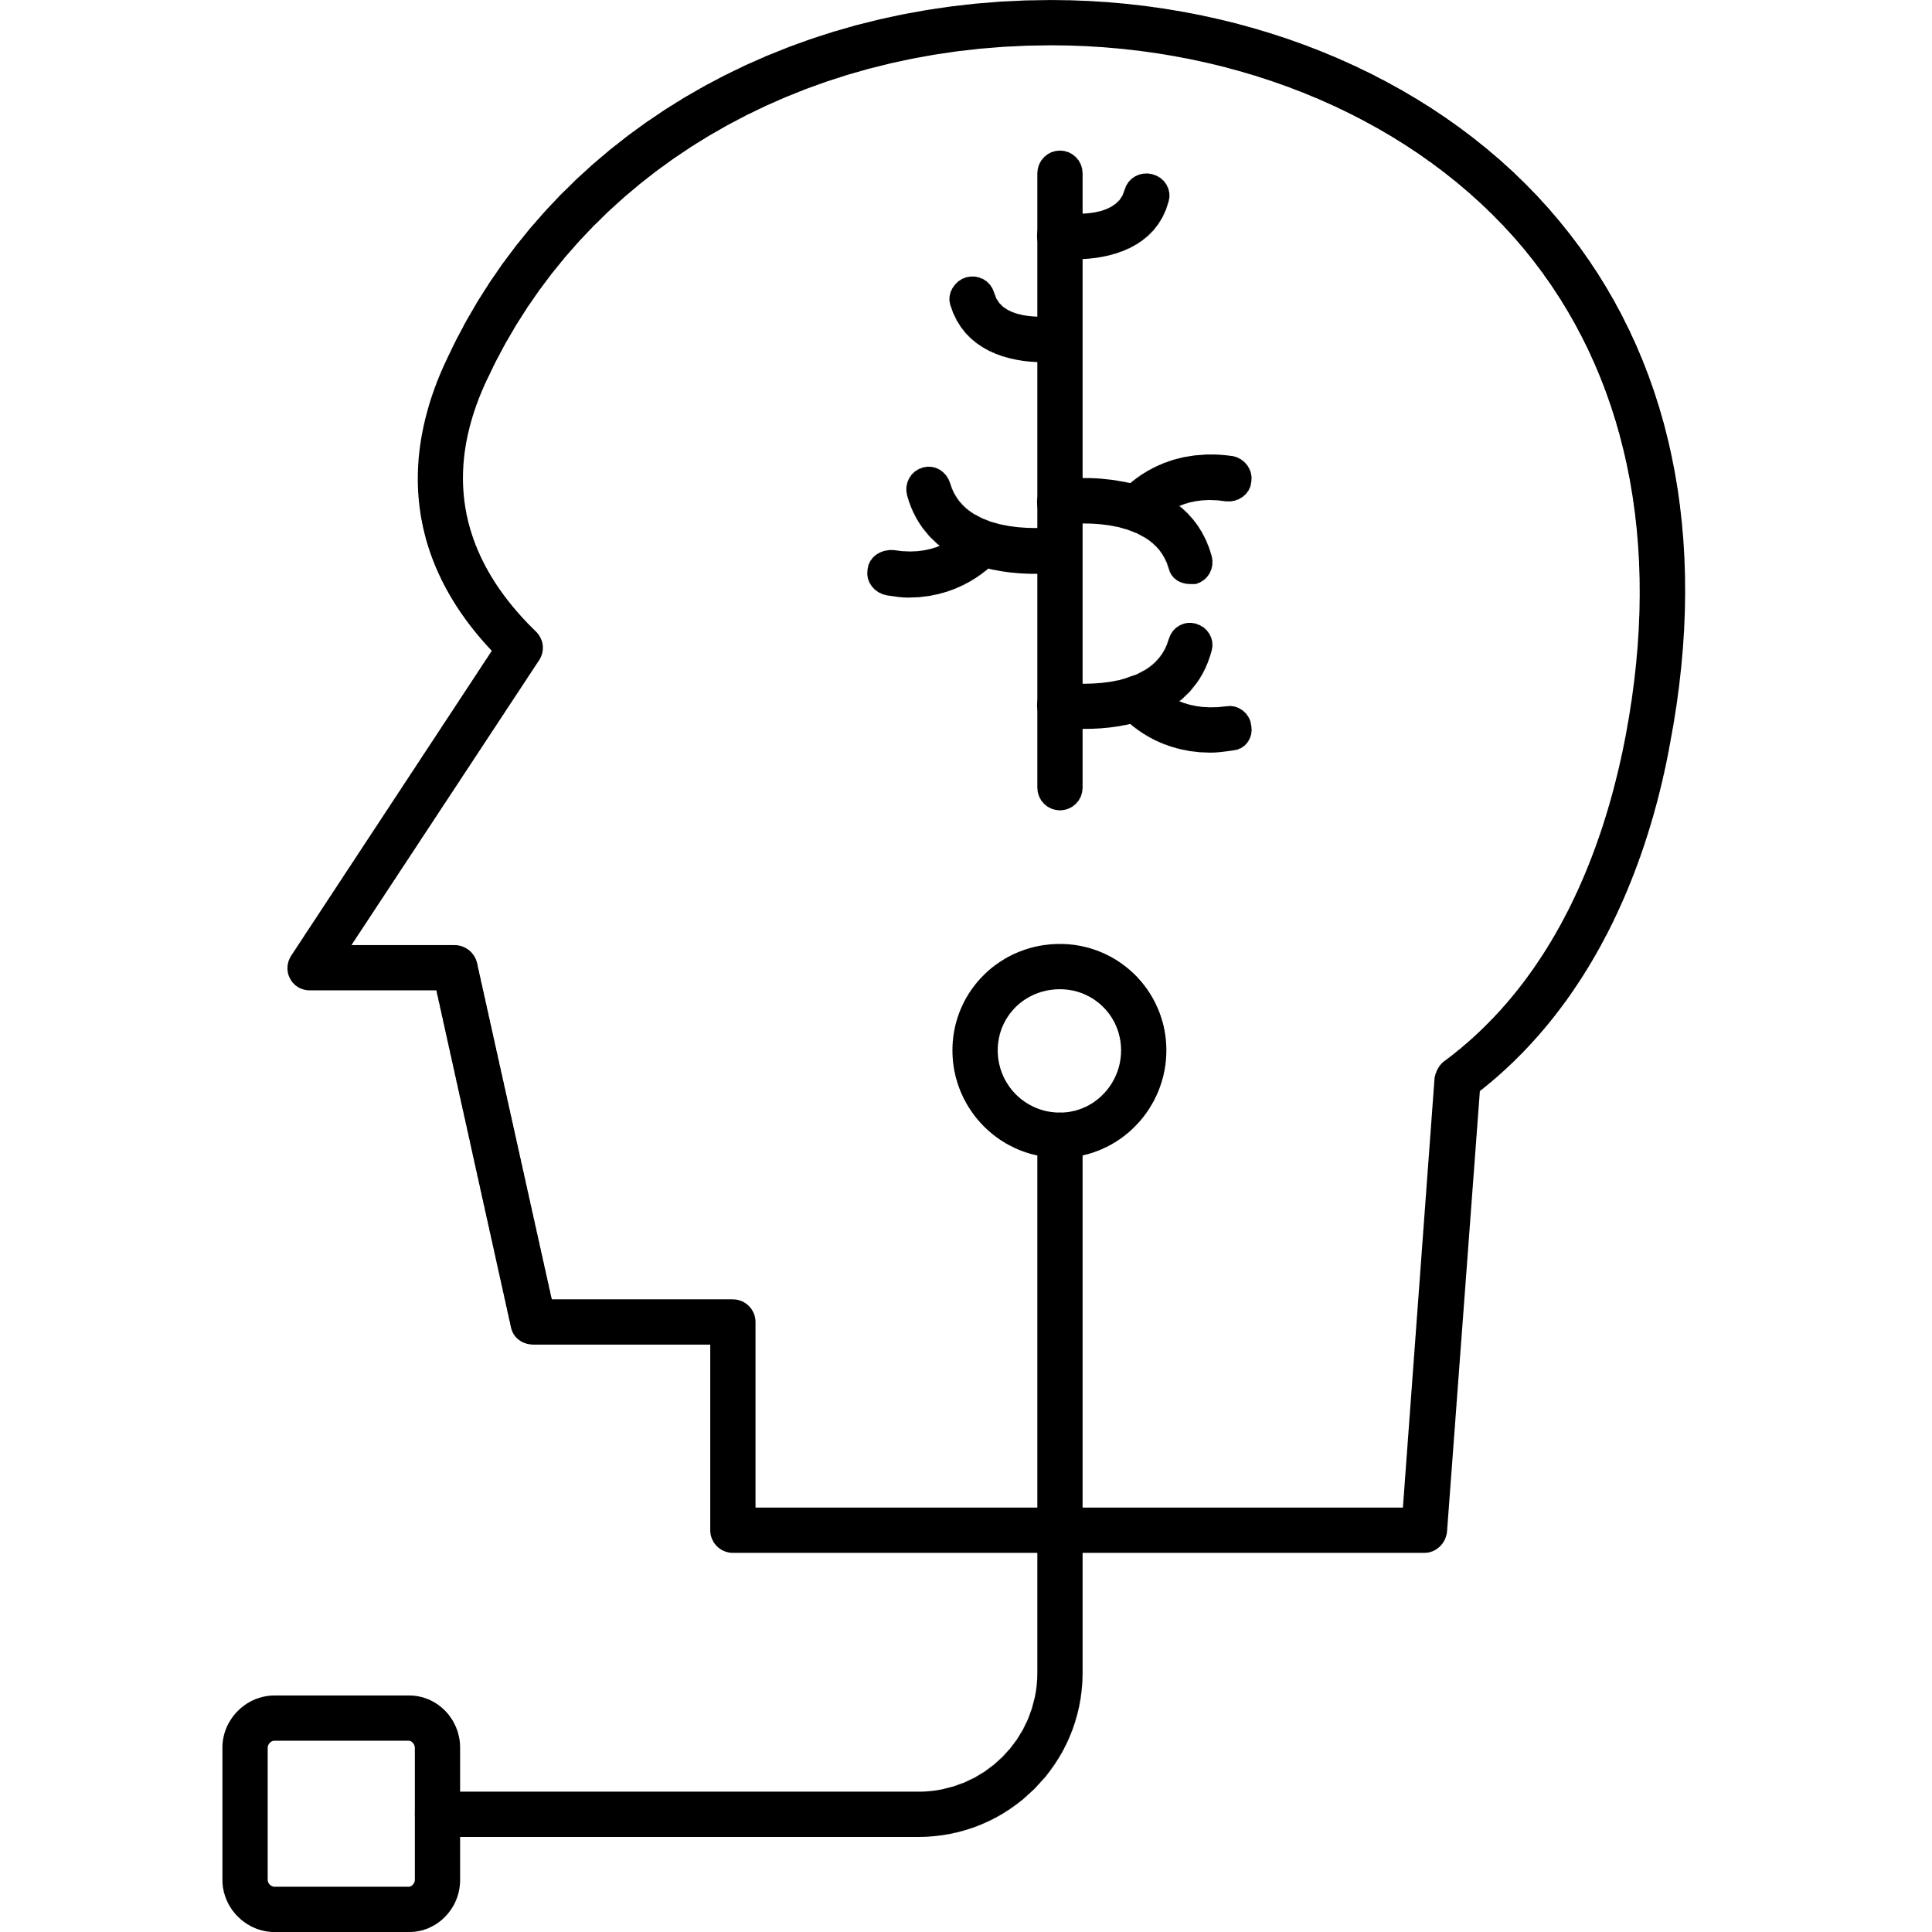
4.3 Acute Treatment Options
Ditans (5-HT1F Agonists)
Neuromodulation Devices
Anti-Nausea Medications
Remote Electrical Neuromodulation (REN), External Vagus Nerve Stimulation (VNS)
Metoclopramide, Prochlorperazine
Lasmiditan
Efficacy: Suitable for patients with cardiovascular risk
Side Effects: Drowsiness, dizziness, driving restrictions after use
Contraindications: Avoid if patient needs to drive or operate heavy machinery
Efficacy: Useful for patients with medication intolerance
Side Effects: No systemic side effects
Contraindications: Not for patients with implanted stimulators or pacemakers. May not be practical for all patients (device access, cost)
Efficacy: Often used in ER settings for severe attacks
Side Effects: Drowsiness, restlessness
Contraindications: Use cautiously in patients with movement disorders

Slide 8
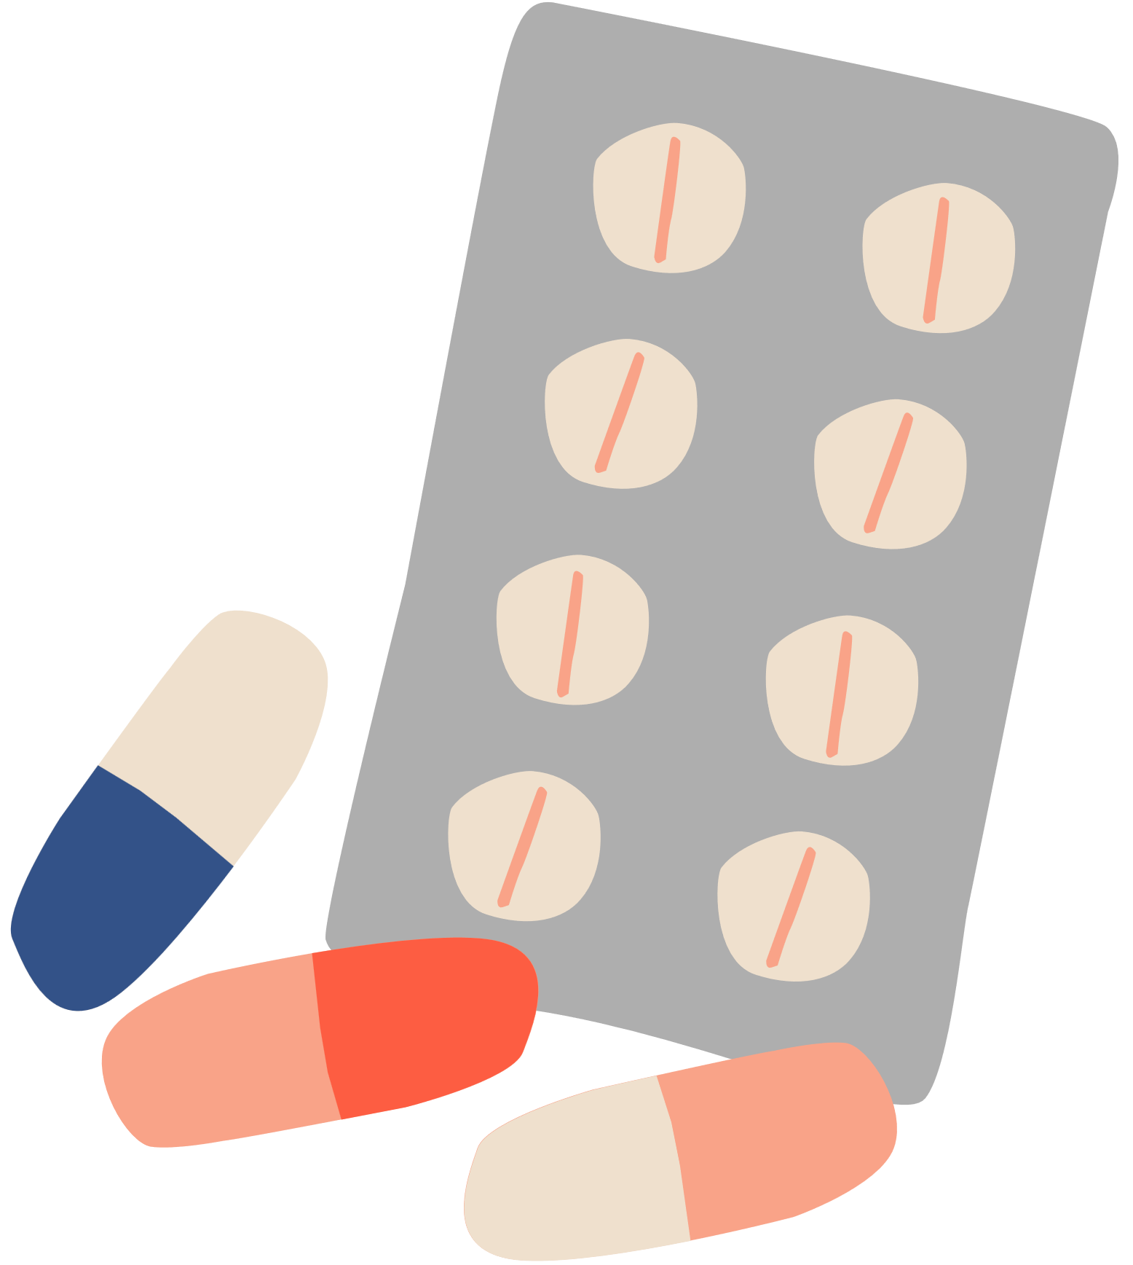
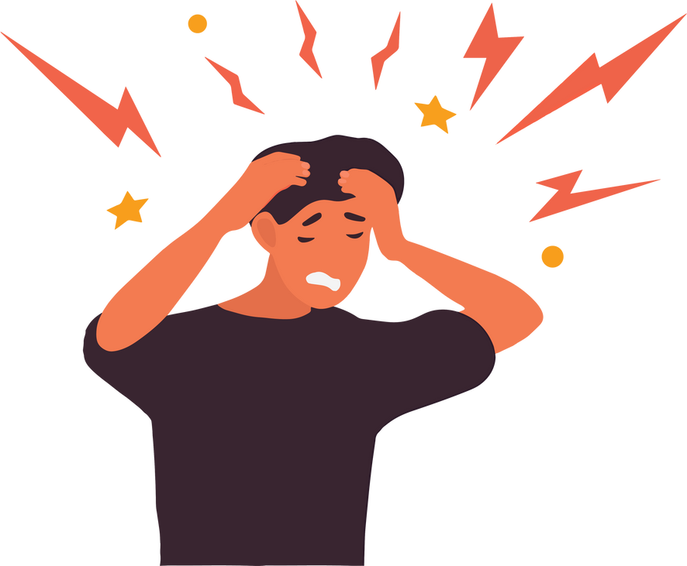
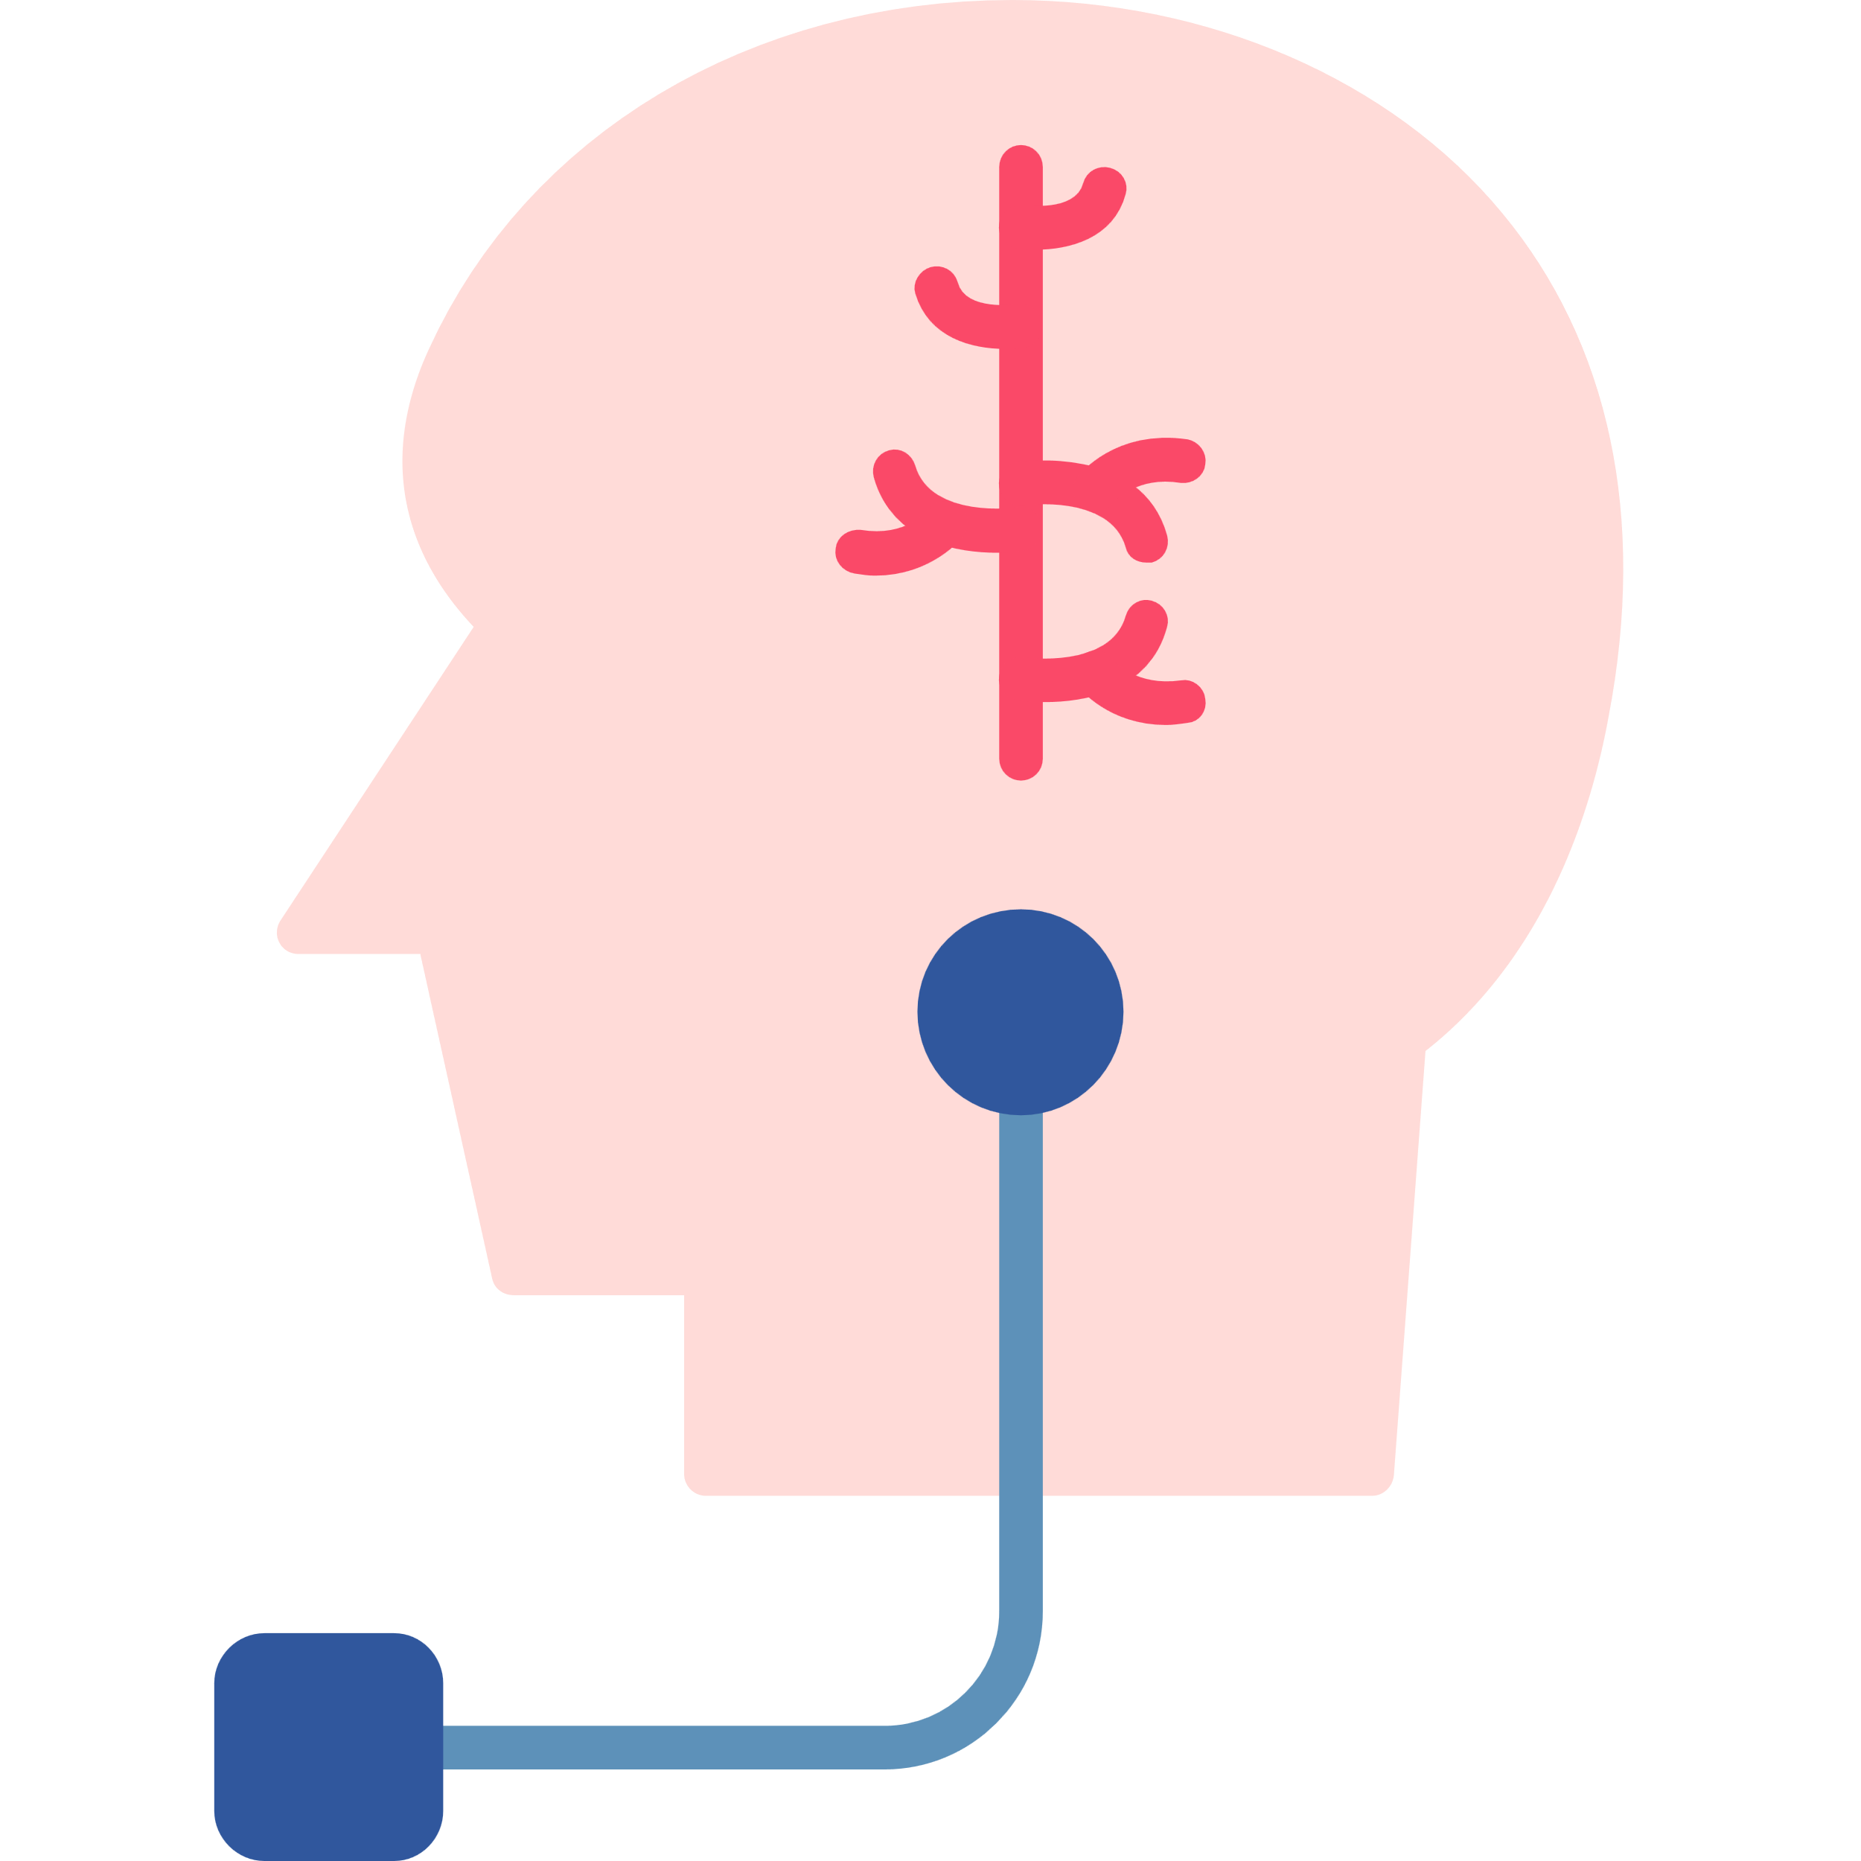
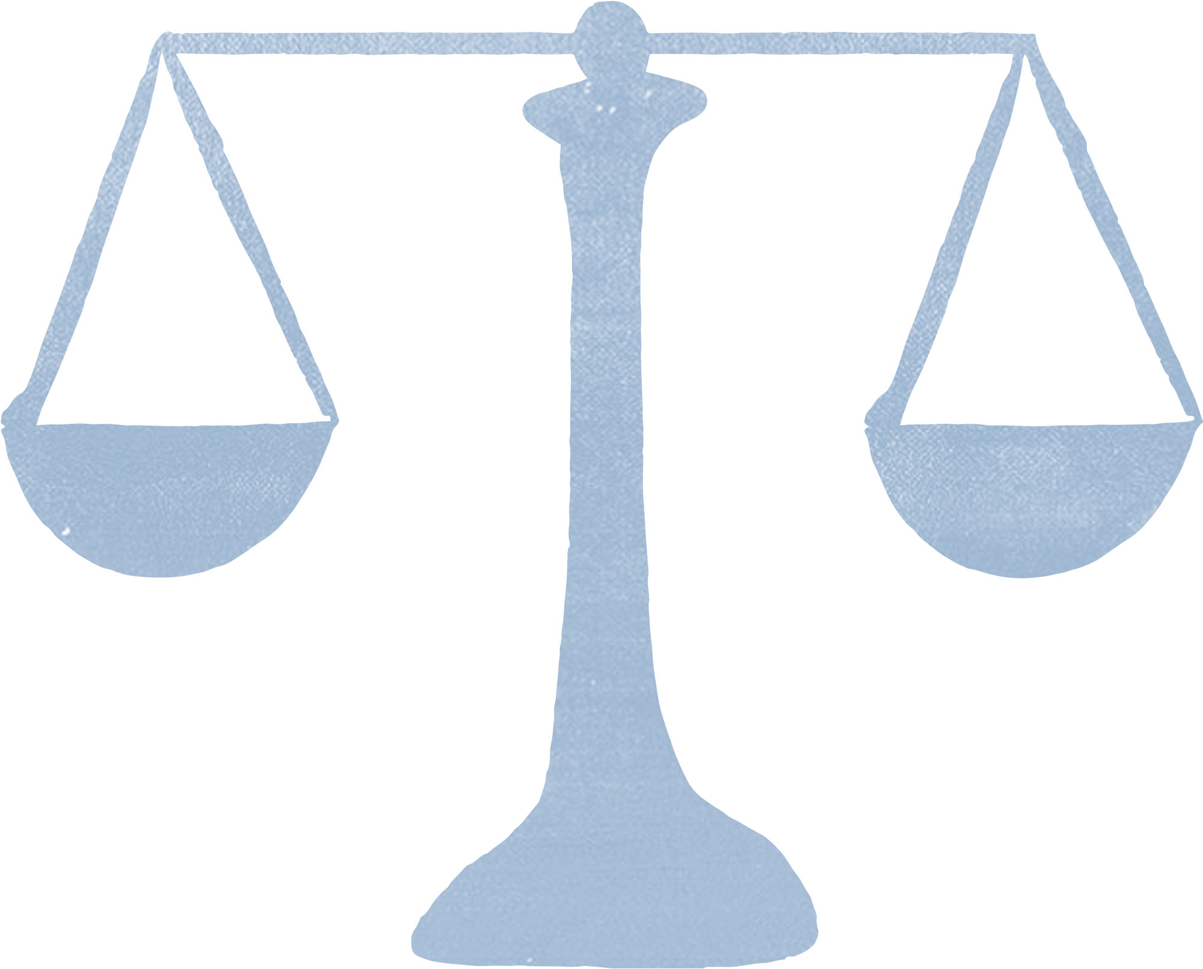
4.4 Choosing the Right Acute Treatment
Personalized treatment selection based on attack severity, comorbidities, and individual response to therapy is crucial to migraine care.
Using Triptans
  Migraine Severity
  Beyond Drugs
  Balancing Treatment
Triptans remain the first-line treatment for many, but gepants and ditans offer alternatives for those who cannot use them.
NSAIDs work well for mild to moderate migraines but may not be enough for severe attacks.
Neuromodulation devices provide a non-drug option with no systemic side effects.
Patients on preventive treatment still need acute options for breakthrough migraines.

Slide 9
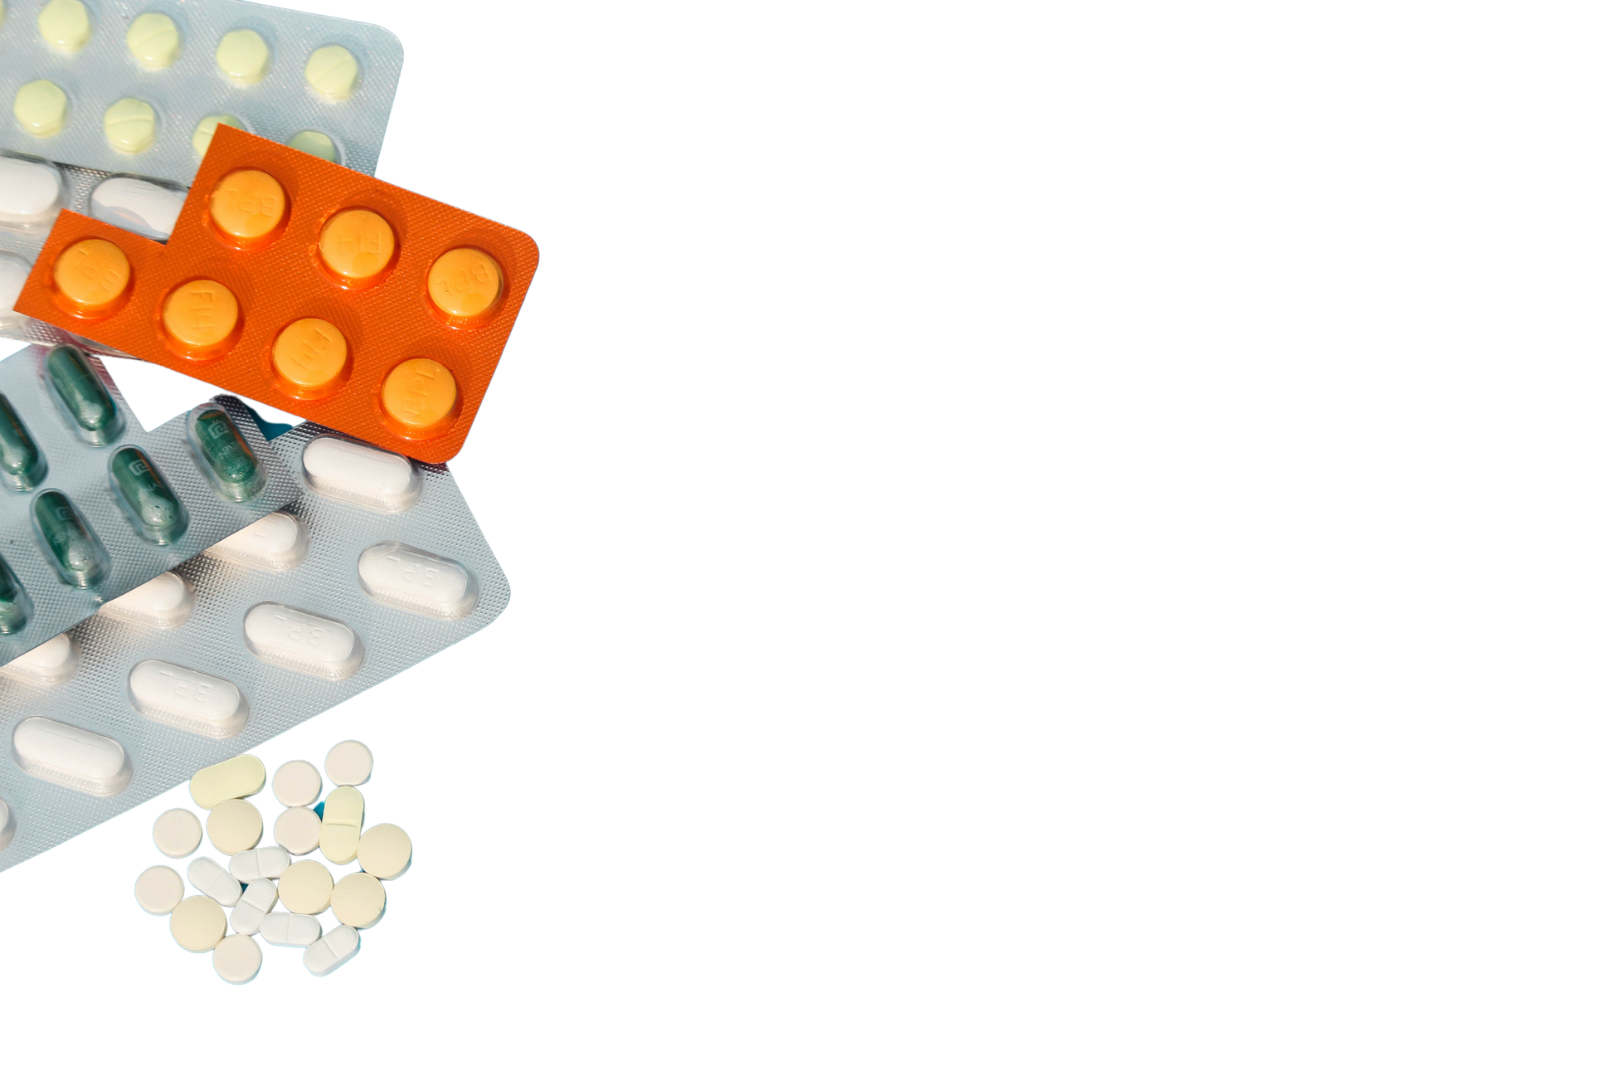
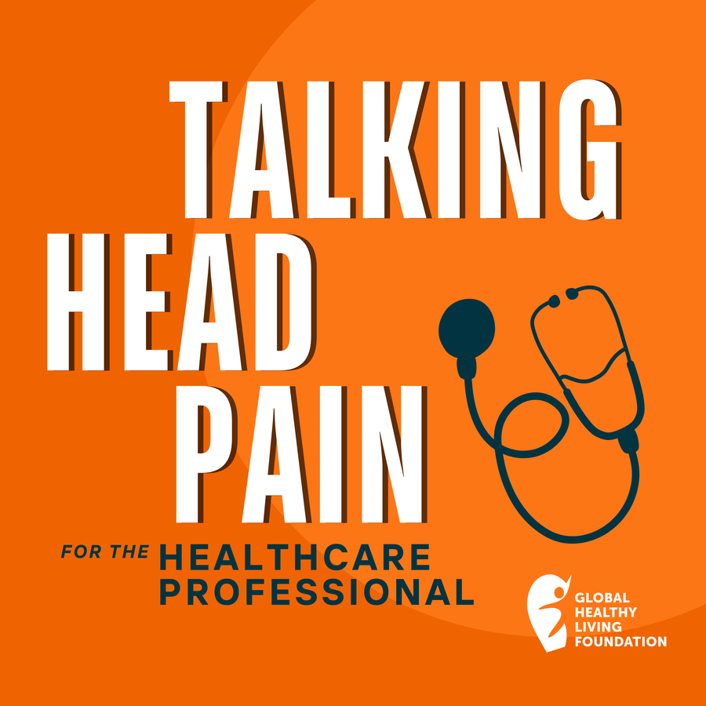

Medication Adaptation Headache
Medication adaption headache or medication overuse headache happens when someone takes acute migraine or pain-relief medication too often—usually more than 10–15 days a month, depending on the medication. Over time, the brain becomes more sensitive to pain, and instead of helping, the medication actually causes more headaches.
A balanced treatment plan, including prevention and acute medication can help avoid medication adaption headache.
Listen to learn more

Slide 10
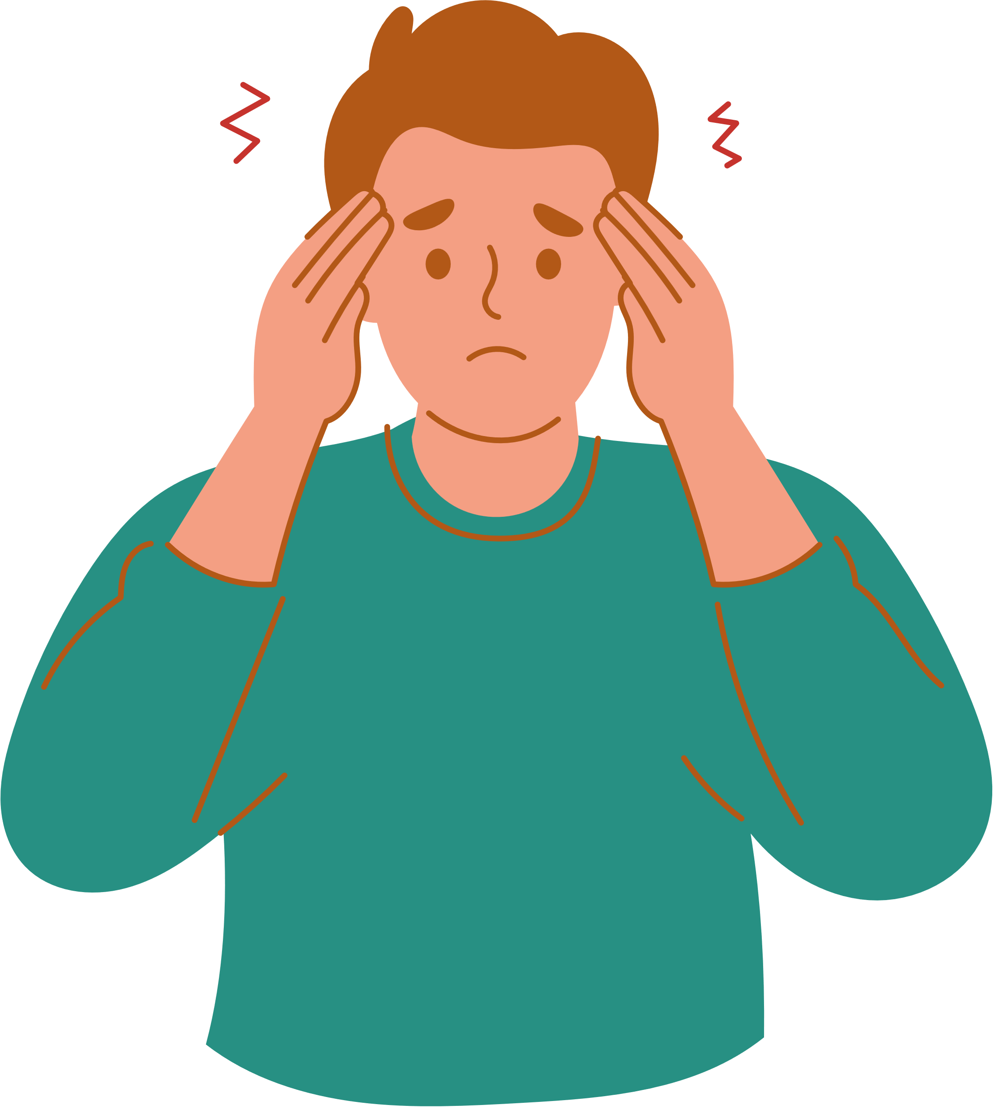

4.5 What Patients Want You to Know
“I think when we talk about chronic illness in general, we have to redefine what the outcomes of “treatment” look like realistically. We aren’t talking about “getting cured”, we are talking about good “management” of our conditions.
Even if I am taking the best preventive medication in the world, I am still going to have migraines, and I deserve options for when that happens.”
Preventive and acute treatments must work together. All patients with migraine should have acute migraine options discussed with them.
Erik, Migraine Patient

Slide 11
Your Next Steps
TEST YOUR KNOWLEDGE | LISTEN TO PATIENT STORIES | REFLECT ON YOUR PRACTICES
Take the short quiz to test your knowledge on key learnings from this module! | Listen to Talking Head Pain: For the Healthcare Professional Episode Three - Breaking Through Pain: Advancements in Acute Migraine Treatment | Reflect: What strategies will you use to communicate the use and importance of acute treatments to patients?

